Slide 1
Continual Learning
Pravin Y Pawar
Adapted from “Designing Machine Learning Systems”
By Chip Huyen

Slide 2
Continual Learning
How do adapt models to data distribution shifts?
The answer is by continually updating our ML models
Continual learning is largely an infrastructural problem
Setting up infrastructure allows to update models as frequently as required
The goal of continual learning is to safely and efficiently automate the update
allows to design an ML system that is maintainable and adaptable to changing environments

Slide 3
What is continual learning?
Many people think of the training paradigm where a model updates itself with every incoming sample in
production
people imagine updating models very frequently, such as every 5 or 10 minutes
Very few companies actually do that!
makes model susceptible to catastrophic forgetting - the tendency of a neural network to completely and abruptly forget
previously learned information upon learning new information
make training more expensive - most hardware backends today were designed for batch processing, so processing only
one sample at a time causes a huge waste of compute power and is unable to exploit data parallelism
Most companies don’t need to update their models that frequently because of two reasons
First, they don’t have enough traffic (i.e., enough new data) for that retraining schedule to make sense
Second, their models don’t decay that fast
If changing retraining schedule from a week to a day gives no return and causes more overhead, there’s no need to do it.

Slide 4
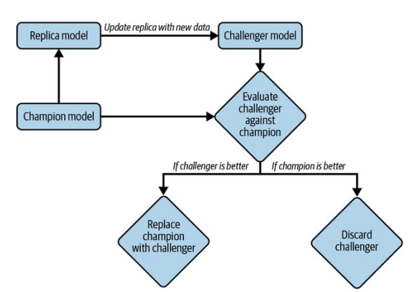
A simplification of how continual learning work in production
Champion-Challenger
The updated model shouldn’t be deployed until it’s been evaluated
means that shouldn’t make changes to the existing
model directly
Instead,
should create a replica of the existing model
update this replica on new data
only replace the existing model with the updated replica if
the updated replica proves to be better
The existing model - champion model
The updated replica - the challenger
An oversimplification of the process for the sake of understanding!
In reality, a company might have multiple challengers at the same time

Slide 5
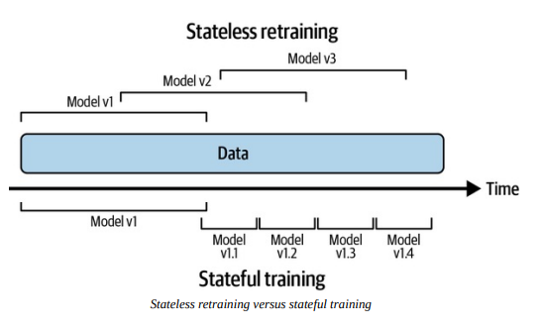
Stateless Retraining Versus Stateful Training
Continual learning isn’t about the retraining frequency,
but the manner in which the model is retrained
Most companies do stateless retraining — the model is trained
from scratch each time
Some follows stateful training — the model continues training on
new data
also known as fine-tuning or incremental learning
Stateful training allows to update model with less data
Training a model from scratch tends to require a lot more data
One beautiful property that is often overlooked is that with stateful training,
it might be possible to avoid storing data altogether

Slide 6
Stateless Retraining Versus Stateful Training(2)
The companies that have most successfully used stateful training
also occasionally train their model from scratch on a large amount of data to calibrate it
Once infrastructure is set up to allow both stateless retraining and stateful training,
the training frequency is just a knob to twist
can update models once an hour, once a day, or whenever a distribution shift is detected
Continual learning is about setting up infrastructure in a way that
allows a data scientist or ML engineer,
to update models whenever it is needed,
whether from scratch or fine-tuning,
to deploy this update quickly

Slide 7
Model iteration vs Data iteration
Stateful training sounds cool, but how does this work if needs to add a new feature or another layer to
model?
Must differentiate two types of model updates:
Model iteration - A new feature is added to an existing model or the model architecture is changed
Data iteration - Model architecture and features remain the same, but refresh this model with new data.
As of today, stateful training is mostly applied for data iteration!
Changing model architecture or adding a new feature still requires training the resulting model from scratch
research shows that it might be possible to bypass training from scratch for model iteration
by using techniques such as knowledge transfer (Google, 2015) and model surgery (OpenAI, 2019)

Slide 8
Why Continual Learning?
Why would you need the ability to update your models as fast as you want?
The first use case of continual learning is to combat data distribution shifts,
especially when the shifts happen suddenly
Another use case of continual learning is to adapt to rare events
Can help overcome is the continuous cold start problem
“Why continual learning?” should be rephrased as “why not continual learning?”
Continual learning is a superset of batch learning - allows to do everything traditional batch learning can do
If continual learning takes the same effort to set up and costs the same to do as batch learning,
there’s no reason not to do continual learning!
MLOps tooling for continual learning is maturing, which means, one day not too far in the future,
it might be as easy to set up continual learning as batch learning

Slide 9
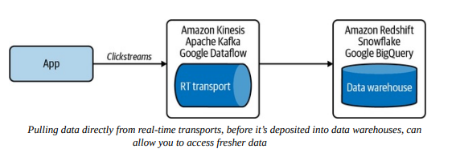
Continual Learning Challenges
Fresh data access challenge - Data Sources
If want to update model every hour, need new data every hour!
Data Sources
Currently, many companies pull new training data from their data warehouses
The speed at which data can be pulled from data warehouses depends on the speed at which this data is deposited into data warehouses
The speed can be slow, especially if data comes from multiple sources
An alternative is to allow pull data before it’s deposited into data warehouses,
e.g., directly from real-time transports such as Kafka and Kinesis that transport data from applications to data warehouses

Slide 10
Continual Learning Challenges(2)
Fresh data access challenge - Labelling
If model needs labeled data to update, data will need to be labeled as well!
In many applications, the speed at which a model can be updated is bottlenecked by the speed at which data is labeled
The best candidates for continual learning are tasks where can get natural labels with short feedback loops
dynamic pricing, estimating time of arrival, stock price prediction,
ads click-through prediction, and recommender systems
If model’s speed iteration is bottlenecked by labeling speed,
possible to speed up the labeling process by leveraging programmatic labeling tools like Snorkel to generate fast labels
possible to leverage crowdsourced labels to quickly annotate fresh data
Given that tooling around streaming is still nascent,
architecting an efficient streaming-first infrastructure for accessing fresh data and extracting fast labels from real-time
transports can be engineering-intensive and costly

Slide 11
Continual Learning Challenges(3)
Evaluation challenge
ML systems make catastrophic failures in production,
from millions of minorities being unjustly denied loans,
to drivers who trust autopilot too much being involved in fatal crashes
The biggest challenge is in making sure that this update is good enough to be deployed!
The risks for catastrophic failures amplify with continual learning
More frequently models are updated, the more opportunities there are for updates to fail
Makes models more susceptible to coordinated manipulation and adversarial attack
To avoid similar or worse incidents, it’s crucial to thoroughly test each of model updates to ensure its
performance and safety before deploying the updates to a wider audience.
When designing the evaluation pipeline for continual learning, keep in mind that evaluation takes time,
which can be another bottleneck for model update frequency.

Slide 12
Continual Learning Challenges(4)
Algorithm challenge - “softer” challenge
Challenge as it only affects certain algorithms and certain training frequencies.
only affects matrix-based and tree-based models that want to be updated very fast (e.g., hourly)
Consider two different models:
a neural network and a matrix-based model, such as a collaborative filtering model
The collaborative filtering model uses a user-item matrix and a dimension reduction technique
A neural network model
Can update model with a data batch of any size
Can even perform the update step with just one data sample
Collaborative filtering model
For updating model, first need to use the entire dataset to build the user-item matrix before performing dimensionality reduction on it
if matrix is large, the dimensionality reduction step would be too slow and expensive to perform frequently
less suitable for learning with a partial dataset than the preceding neural network model

Slide 13
Four Stages of Continual Learning
How to overcome these challenges and make continual learning happen?
The move toward continual learning happens in four stages
Stage 1: Manual, stateless retraining
Stage 2: Automated retraining
Stage 3: Automated, stateful training
Stage 4: Continual learning

Slide 14
Four Stages of Continual Learning(2)
Stage 1: Manual, stateless retraining
In the beginning, the ML team often focuses on developing ML models to solve as many business problems as possible
Because team is focusing on developing new models, updating existing models takes a backseat
No fixed frequency to update the models
Update an existing model only when the following two conditions are met:
the model’s performance has degraded to the point that it’s doing more harm than good
team has time to update it
The process of updating a model is manual and ad hoc
Someone, usually a data engineer, has to query the data warehouse for new data.
Someone else cleans this new data, extracts features from it, retrains that model from scratch on both the
old and new data, and then exports the updated model into a binary format.
Someone else takes that binary format and deploys the updated model.
A vast majority of companies outside the tech industry—
e.g., any company that adopted ML less than three years ago and doesn’t have an ML platform team—are in this stage

Slide 15
Four Stages of Continual Learning(3)
Stage 2: Automated retraining
After a few years, team has managed to deploy models to solve most of the obvious problems
Priority is no longer to develop new models, but to maintain and improve existing models
The ad hoc, manual process of updating models mentioned from the previous stage has grown into a pain point too big to be ignored
Team decides to write a script to automatically execute all the retraining steps
run periodically using a batch process such as Spark
Status
Most companies with somewhat mature ML infrastructure are in this stage
Some sophisticated companies run experiments to determine the optimal retraining frequency
For most companies in this stage, the retraining frequency is set based on gut feeling
e.g., “once a day seems about right” or “let’s kick off the retraining process each night when we have idle compute"

Slide 16
Four Stages of Continual Learning(4)
Stage 2: Automated retraining - Requirements for setup
If company has ML models in production,
likely that company already has most of the infrastructure pieces needed for automated retraining
The feasibility of this stage revolves around the feasibility of writing a script to automate workflow and
configure infrastructure to automatically:
1. Pull data.
2. Downsample or upsample this data if necessary.
3. Extract features.
4. Process and/or annotate labels to create training data.
5. Kick off the training process.
6. Evaluate the newly trained model.
7. Deploy it.
In general, the three major factors that will affect the feasibility of this script are:
scheduler,
data,
and model store

Slide 17
Four Stages of Continual Learning(4)
Stage 3: Automated, stateful training
Need to reconfigure automatic updating script so that, when the model update is kicked off
it first locates the previous checkpoint and loads it into memory before continuing training on this checkpoint
Requirements
The main thing needed at this stage is a way to track data and model lineage
Imagine you first upload model version 1.0
is updated with new data to create model version 1.1, and so on to create model 1.2
Another model is uploaded and called model version 2.0
is updated with new data to create model version 2.1
After a while, you might have model version 3.32, model version 2.11, model version 1.64
Might want to know
how these models evolve over time,
which model was used as its base model,
which data was used to update it so that you can reproduce and debug it
Need model store that has this model lineage capacity

Slide 18
Four Stages of Continual Learning(5)
Stage 4: Continual learning
At stage 3, models are still updated based on a fixed schedule set out by developers
Finding the optimal schedule isn’t straightforward and can be situation-dependent
might want models to be automatically updated whenever data distributions shift and the model’s performance plummets
The move from stage 3 to stage 4 is steep!
Requirements
First need a mechanism to trigger model updates
Time-based - every five minutes
Performance-based - whenever model performance plummets
Volume-based - whenever the total amount of labeled data increases by 5%
Drift-based - whenever a major data distribution shift is detected
For this trigger mechanism to work, need a solid monitoring solution
Hard part is not to detect the changes, but to determine which of these changes matter
If monitoring solution gives a lot of false alerts, model will end up being updated much more frequently than it needs to be
Need a solid pipeline to continually evaluate model updates.
Writing a function to update models isn’t much different from stage 3
Hard part is to ensure that the updated model is working properly

Slide 19
How Often to Update Your Models?
Depends on how much gain model will get from being updated with fresh data
The more gain model can get from fresher data, the more frequently it should be retrained
The question on how often to update your model is a difficult one to answer!
In the beginning, when infrastructure is nascent and the process of updating a model is manual and slow, the answer is: as often as you can.
As infrastructure matures and the process of updating a model is partially automated and can be done in a matter of hours, if not minutes,
the answer to this question is contingent on the answer to the following question:
“How much performance gain would I get from fresher data?”
Points to be considered
Value of data freshness
Model iteration versus data iteration

Slide 20
Value of data freshness
The question of how often to update a model becomes a lot easier
if knows how much the model performance will improve with updating
For example,
If switch from retraining model every month to every week, how much performance gain can we get?
What if we switch to daily retraining?
People keep saying that data distributions shift, so fresher data is better,
but how much better is fresher data?
One way to figure out the gain is by training model on the data from different time windows in the past and
evaluating it on the data from today to see how the performance changes.

Slide 21
Model iteration versus data iteration
Not all model updates are the same - can be model iteration or data iteration!
Might wonder not only how often to update model, but also what kind of model updates to perform
In theory, can do both types of updates
In practice, should do both from time to time
The more resources spend in one approach, the fewer resources can be spent in another
if iterating on data doesn’t give much performance gain, then should spend resources on finding a better model
if finding a better model architecture requires 100X compute for training and gives 1% performance
whereas updating the same model on data from the last three hours requires only 1X compute and also gives 1% performance gain, will be better off iterating on data
Currently no book can give the answer on which approach will work better for specific model on specific task
have to do experiments to find out.

Slide 22
Thank You!
In our next session:

